Slide 1
Riker Sedation-Agitation Scale (SAS)

Slide 2
What?
Helps the nurse to separate sedated patients into those who can eventually wake-up
Nurse can also identify those who can be awaken but can arouse and those who can’t be aroused

Slide 3
When?
Used for patients who are on sedation
Assed every vital signs taking

Slide 4
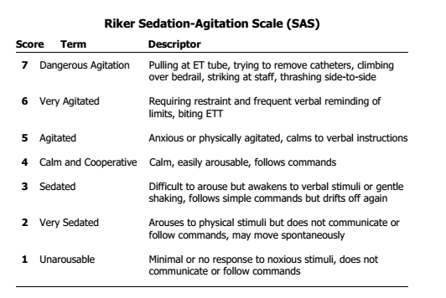
How?

Slide 5
